Slide 1
Term 4 - ML2
Rupinder Kohli
March 2020 cohort

Slide 2
An attempt has been made to find the clusters of items in the customer shopping basket
https://raw.githubusercontent.com/rupkohli/DS_ML_Research/main/clustering/groceries.csv
Define Problem Statement
Perform EDA
Feature Engineering
Create Model
Evaluate Model

Slide 3
Define Problem & Approach to solve

Slide 4
Problem Statement:
As the owner of the store, I need to understand the products the customers are buying
Evaluate the clusters of shopping baskets.

Slide 5
Approach:
To understand consumer behavior and develop customer attributes or archetypes, we will need to use the clustering technique.
Since there is no target variable when evaluating the customer baskets, we will need to apply an unsupervised algorithm to find how data is logically grouped together.
The following algorithms can be applied to learn more about customer's baskets or shopping list -
- K-Means (K-Mode) clustering
- Naive Bayes algorithm

Slide 6
EDA
understanding the dataset

Slide 7
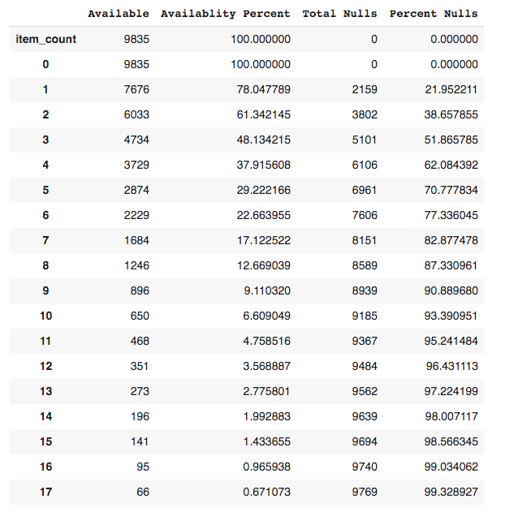
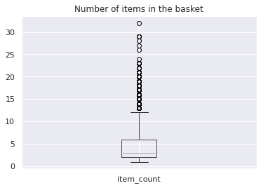
About Dataset
Categorical dataset
9835 baskets
169 unique items
Range of 1-32 items in baskets
463 repeated baskets
Customers buy atleast 1 item from the store
Atleast 30% baskets have atleast 6 items
Less than 1% Baskets have more than 16 items

Slide 8
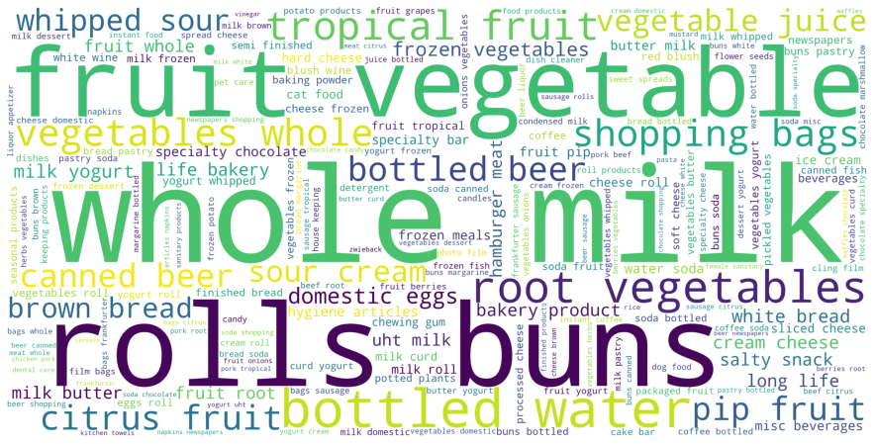
Fast going Items
Notes:
Iteration 1 of the word cloud shows that the word “vegetable” is spelt multiple ways

Slide 9
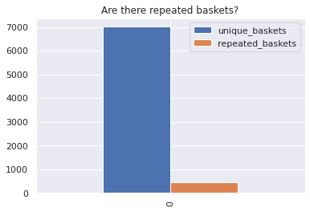
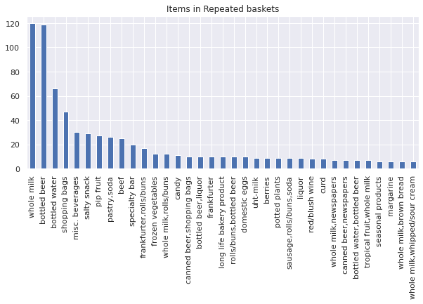
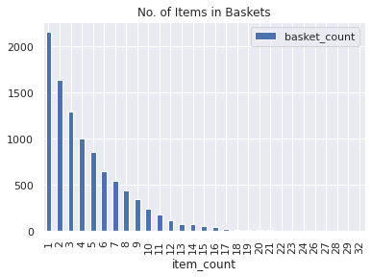
While building the cluster model, we should be analysing the baskets with atleast 9 items; we can confirm once we do a PCA (principal component analysis)
How does the customer baskets look like

Slide 10
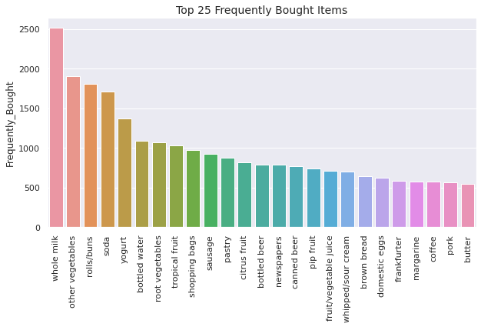
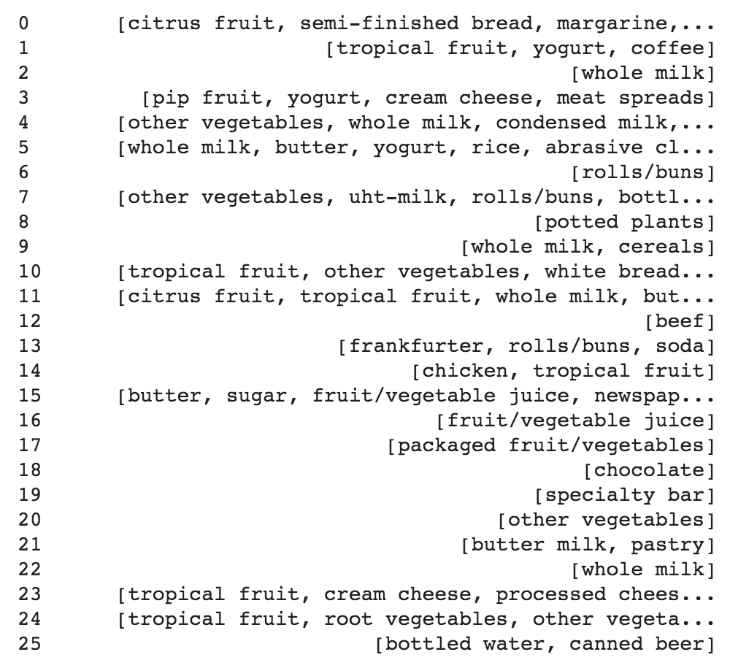
What does customer buy

Slide 11
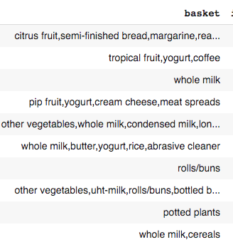
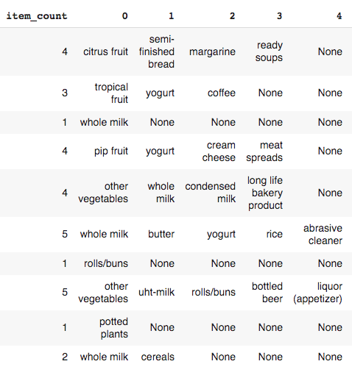
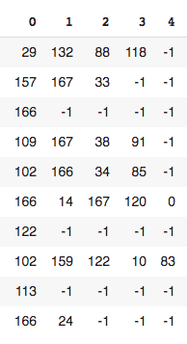
RAW
ITEMISED
ENCODED
Data Setup - Encode the data

Slide 12
Principal Component Analysis
To confirm the number of items to be considered in clustering

Slide 13
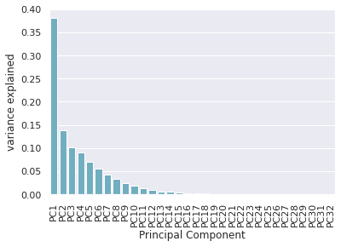
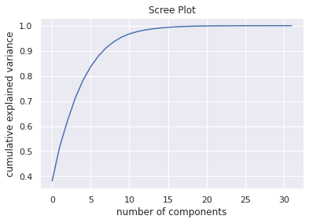
Indicates the consideration should be given to baskets with atleast 9 items
PCA on the encoded dataset

Slide 14
K-Means Clustering
To cluster the items / baskets

Slide 15
K-Means Clustering
- Unsupervised learning algorithm
- Forms clusters of data based on similar instances
- Does not respect null values

Slide 16
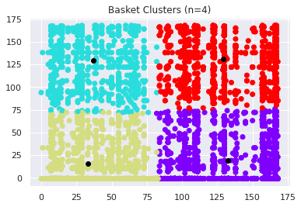
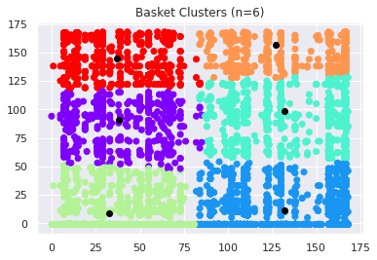
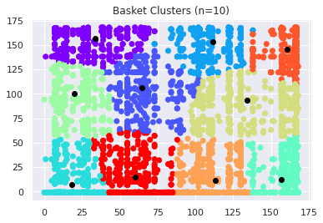
Assumptions -
No null values in dataset
No categorical data
For visualisations - considered baskets with 2 items
K-Means on the encoded dataset
Notes:
Need to understand how to visualise baskets with 6-9 items

Slide 17
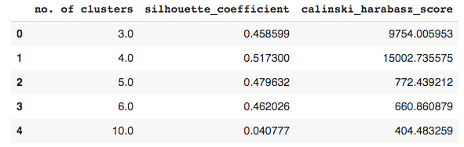
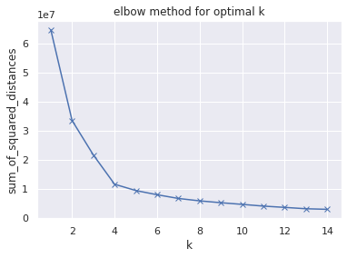
Looking at the Cluster Scores both the silhouette coefficient and cv score are highest with 4 clusters, we can conclude that the optimum number of clusters should be 4 i.e. the optimal number of items in the basket are 4
K-Means - Evaluation

Slide 18
K-Mode Clustering
To view the clustered items

Slide 19
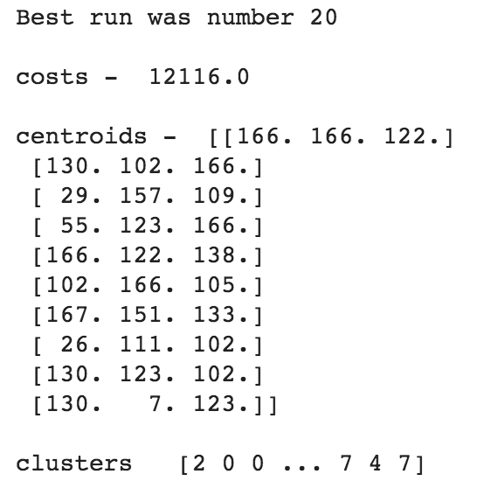
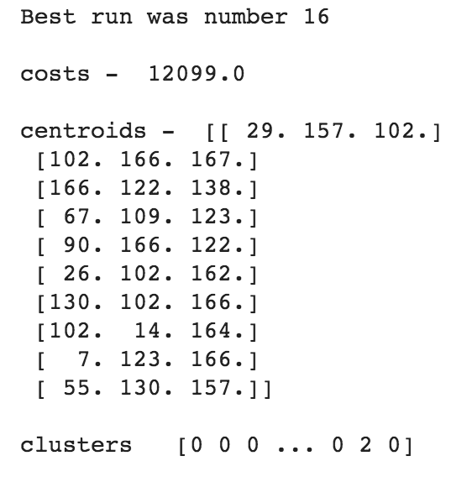
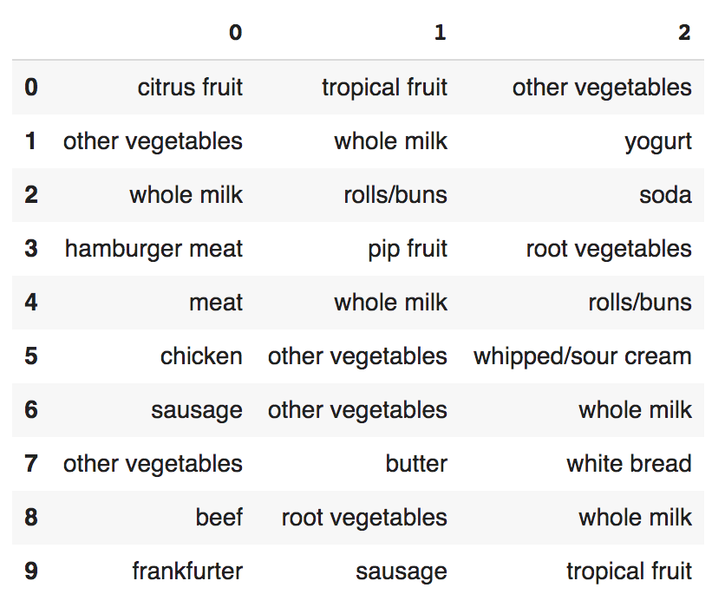
K-Mode Clustering
Unsupervised learning algorithm
Forms clusters of data based on similar instances
Applicable only if there is categorical data
The efficiency of the algorithm is based on the distance between 2 rows
The algorithm was executed multiple times to reach an optimised cost
First pass of the algorithm was run with 3 items per basket which was later extended to 10 items in basket
Run 1
Run n
Item Clusters

Slide 20
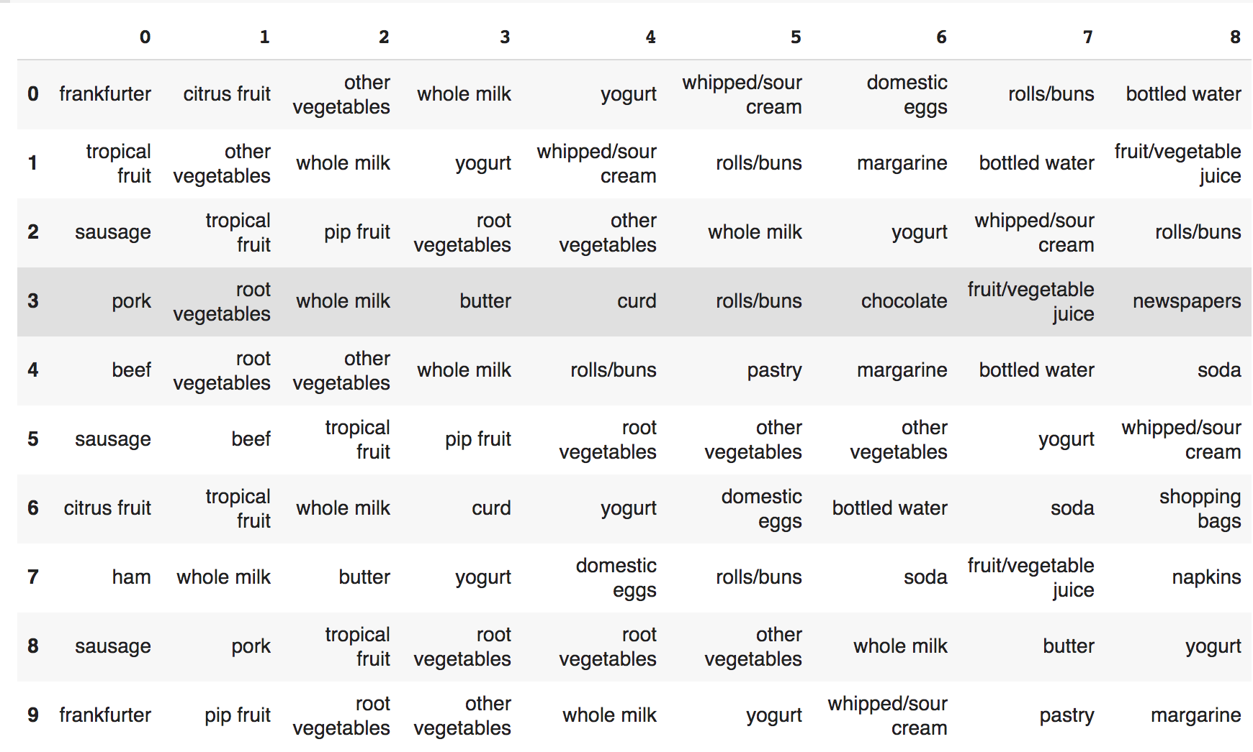
Analysing 1246 baskets will 9 items each
Outcome is a cluster of 10 baskets
K-Mode clusters on dataset

Slide 21
Evaluation
Based on the generated Basket Clusters, the following products are fast flowing -
WHOLE MILK & ROLLS/BUNS & SODA combinations were found in 87 baskets
WHOLE MILK & YOGURT was part of 551 baskets
WHOLE MILK was part of 2513 baskets
YOGURT was part of 1372 baskets
WHOLE MILK & PASTRY was part of 1372 baskets
FRANKFURTER was part of 580 baskets

Slide 22
Conclusions
The Problem statement as identified for the project was “An attempt has been made to find the clusters of items in the customer shopping basket”
The Approach was to “Identify the cluster of baskets with similar items”
The Conclusion Based on the application of the K-Means and K-Mode algorithm
The baskets with 3, 4 and 9 items were clustered together successfully with the best possible cost
Cross evaluated manually to understand if the clusters were correctly formed
Had planned to apply the Naive Bayes algorithm to predict if buying “whole milk” what is the probability the customer will buy “yogurt” as well, due to the paucity of time it wasn’t possible.

Slide 23
THANK YOU!

